Slide 1
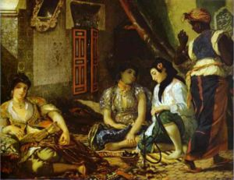
Orientalism (Part 1)

Slide 2


Slide 3
Orientalism describes the various disciplines, institutions, processes of investigation and styles of thought by which Europeans came to 'know' the 'Orient' over several centuries, and which reached their height during the rise and consolidation of nineteenth century imperialism.

Slide 4
Key concepts
‘The other’
The collusion of power and knowledge

Slide 5
'The Sanskrit language, whatever its antiquity, is of a wonderful structure, more perfect than the Greek, more copious than the Latin, and more exquisitely refined than either, yet bearing to both of them a stronger affinity, both in the roots of verbs, and in the forms of grammar, than could possibly have been produced by accident; so strong, indeed, that no philologer could examine them all three, without believing them to have sprung from some common source, which, perhaps, no longer exists' (Asiatic Researches 1788 cited in Poliakov 1974: 190).

Slide 6
William Jones
Revising linguistic history.
National and cultural identity, "the authentic and useful science of linguistics became absorbed in the crazy doctrine of 'racial anthropology'" (Poliakov 1974: 193).
The link between language and identity.
"Every person, however slightly he may be acquainted with the affairs of our time, sees clearly the actual inferiority of Mohammedan countries" (Renan, 1896: 85).

Slide 7
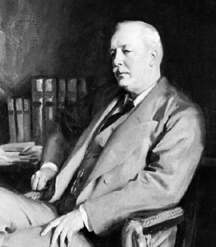
Lord Cromer
"trained intelligence works like a piece of mechanism," the mind of the Oriental, "like his picturesque streets, is eminently wanting
in symmetry" (Said, 1978 : 38).

Slide 8
"Indo-European" group of languages, at different times called the "Japhetic" languages (after Noah's son Japheth),
"Semitic" and "Hamitic" languages which derived from his other sons (Shem and Ham), or "Indo-German," began to be called "Arian" from their supposed origin round Lake Aries in Asia

Slide 9
"A Uniquely Punishing Destiny" - The Worldliness of Orientalism'
To reverse the 'gaze' of the discourse,
To analyze it from the point of view of an 'Oriental' - To compile an "inventory the traces upon. . . the Oriental subject, of the culture whose domination has been so powerful a fact in the life of all Orientals" (Said 1978: 25).

Slide 10
'The web of racism, cultural stereotypes, political imperialism, dehumanizing ideology holding in the Arab or the Muslim is very strong indeed, and it is this web which every Palestinian has come to feel as his uniquely punishing destiny....The nexus of knowledge and power creating 'the oriental' and in a sense obliterating him as a human being is therefore not for me an exclusively academic matter. Yet it is an intellectual matter of some very obvious importance' (1978: 27).

Slide 11
Orient/Occident
"we shall have advanced a little in the process of what Raymond Williams has called the unlearning' of 'the inherent dominative mode" (28).

Slide 12
"more often been thought of as a kind of testimonial to subaltern status - the wretched of the earth talking back - than as a multicultural critique of power using knowledge to advance itself “ (336)

Slide 13
Structure
Orientalism as a discursive field
Orientalist Structures and Restructures
Modern Orientalism

Slide 14
"it is also the place of Europe's greatest and richest and oldest colonies, the source of its civilizations and languages, its cultural contestant and most recurring images of the Other" (1978: 1).

Slide 15
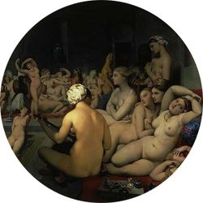
Orientalism
An academic discipline,
A style of thought and
A corporate institution for dealing with the Orient.

Slide 16
"the discipline by which the Orient was (and is) approached systematically, as a topic of learning, discovery and practice" (73).
"based upon an ontological and epistemological distinction" (2)

Slide 17
Ontology
Epistemology

Slide 18
The scope of orientalism
The collusion between knowledge and power
"We know the civilization of Egypt better than we know any other country" (Arthur Baldwin)
"To have such knowledge of such a thing [as Egypt] is to dominate it, to have authority over it. . . since we know it and it exists, in a sense, as we know it" (ibid)
: "England knows Egypt; Egypt is what England knows; England knows that Egypt cannot have self-government; England confirms that by occupying Egypt; for the Egyptians, Egypt is what England has occupied and now governs; foreign occupation therefore becomes "the vary basis" of contemporary Egyptian civilization"

Slide 19
"the Oriental is depicted as something one judges (as in a court of law), something one studies and depicts (as in a curriculum), something one disciplines (as in a school or prison), something one illustrates (as in a zoological manual). The point is that in each of these cases the Oriental is contained and represented by dominating frameworks" (40).

Slide 20
"which was in many ways the very model of a truly scientific appropriation of one culture by another, apparently stronger one"
"Orientalism was ultimately a political vision of reality whose structure promoted the difference between the familiar (Europe, the West, 'us') and the strange (Orient, the East, 'them')" (43).
"One big division, as between West and Orient, leads to other smaller ones"
"the lenses through which the Orient is experienced, and they shape the language, perception and form of the encounter between East and West" (58).

Slide 21
Metaphor of the theatre
"On this stage will appear figures whose role it is to represent the larger whole from which they emanate. The Orient then seems to be, not an unlimited extension beyond the familiar European world, but rather a closed field, a theatrical stage affixed to Europe" (63).
"shares with magic and with mythology the self-containing, self-reinforcing character of a closed system, in which objects are what they are because they are what they are, for once, for all time, for ontological reasons that no empirical material can either dislodge or alter" (70)

Slide 22
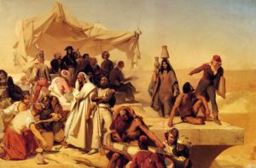
Upsurge in Orientalism and the rise in European imperial dominance during the nineteenth
Napoleon's invasion of Egypt in 1798
Marriage of academic knowledge and political ambition
Tactical approach using Islam
"Quite literally, the occupation gave birth to the entire modern experience of the Orient as interpreted from within the universe of discourse founded by Napoleon in Egypt" (87)
"Its descriptive realism was upgraded and became not merely a style of representation but a language, indeed a means of creation:' (87)

Slide 23
Orientalism and its critics
  The public intellectual
  Dying institution
  Professionalisation
  Secular criticism of analysis
  Intellectual romanticism
  Orientalism as amateur work

Slide 24
Paradoxical nature of Said’s identity
Worldliness

Slide 25
Professor of terror
'whose great insight into modern political life, as it happens, has precisely to do with the special attraction of intellectuals to terror' (Edward Alexander 1989: 49).

Slide 26
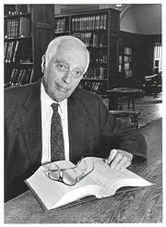
Dennis Porter and Bernard Lewis
'underwritten by a zealotry covered with a veneer of urbanity that has very little in common with the "science" and learning Lewis purports to be upholding' (1985: 13).
'turns out to be, like Lewis's, no more than banal description of a barony violated by a crude trespasser' (1995: 346).
'a disquieting lack of knowledge of what scholars do and what scholarship is all about' (1982, 1982a).

Slide 27
'derive from what to the nineteenth-century mind is the preposterous situation of an Oriental responding to Orientalism's asseverations’ (solemn declaration).
'For unrestrained anti-intellectuals, unen-cumbered by critical self-consciousness, no one has quite achieved the sublime confidence of Bernard Lewis' (1985: 6)

Slide 28
THE FOUCAULT CONNECTION : METHODOLOGICAL CRITICISMS
Truth (knowledge)/Ideology
Discourse (Foucault) versus ideology/hegemony (Gramsci)
'Orientalism in one form or another is not only what we have but all we can ever have' (1983:151).
Counter hegemony

Slide 29
'in the end to suggest alternatives to the discourse of Orientalism is not difficult to explain. First, because he overlooks the potential contradiction between discourse theory and Gramscian hegemony, he fails to historicize adequately the texts he cites and summarizes ... Second, because he does not distinguish the literary instance from more transparently ideological textual forms he does not acknowledge the semi-autonomous and overdetermined character of aesthetic artefacts. Finally, he fails to show how literary texts may in their play establish distance from the ideologies they seem to be reproducing'.
(1983:160)

Slide 30
Aijaz Ahmad
The problem of humanism
Foucault and methodology
Orientalism as alternative to Marxism

Slide 31
In Said’s favour
1) The paradoxes which Said represents and the ambivalence of his position make him fascinating as a critic.
2) Orientalism shows the power of amateurism - its originality, scope and tenacity reveal a certain power to change the way in which we think about global cultural relations. The value of Said’s work lies in the essence of his argument that to know is to have power over and that conversely to have power is to know the world in your own terms.

Slide 32
Said’s response : ‘Orientalism reconsidered’
Continuing influence of earlier traditions of orientalism on politics in the middle east (Trilogy - Question of Palestine/Covering Islam)
Modifying the ‘system building’ nature of the earlier text
Accepting that the critic simply situate himself outside the object of study
A more nuanced account of the effects of orientalism
Reconstituted humanism and avoiding a politics of blame

